Slide 1
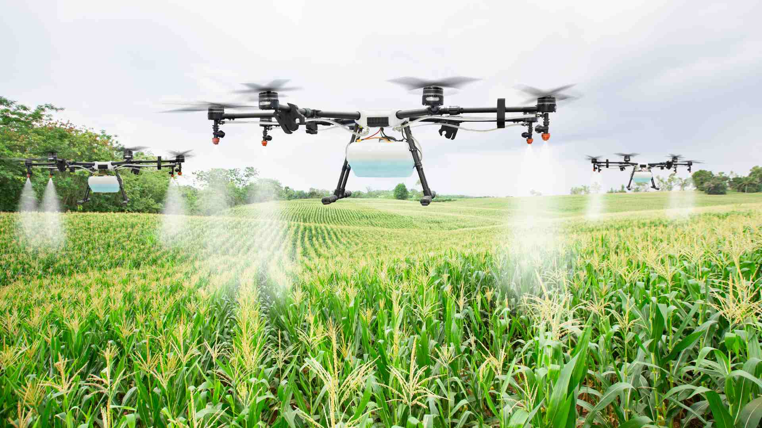
Indian Agriculture Analysis
Presented By: Deborah Nyangige Mosioma

Slide 2
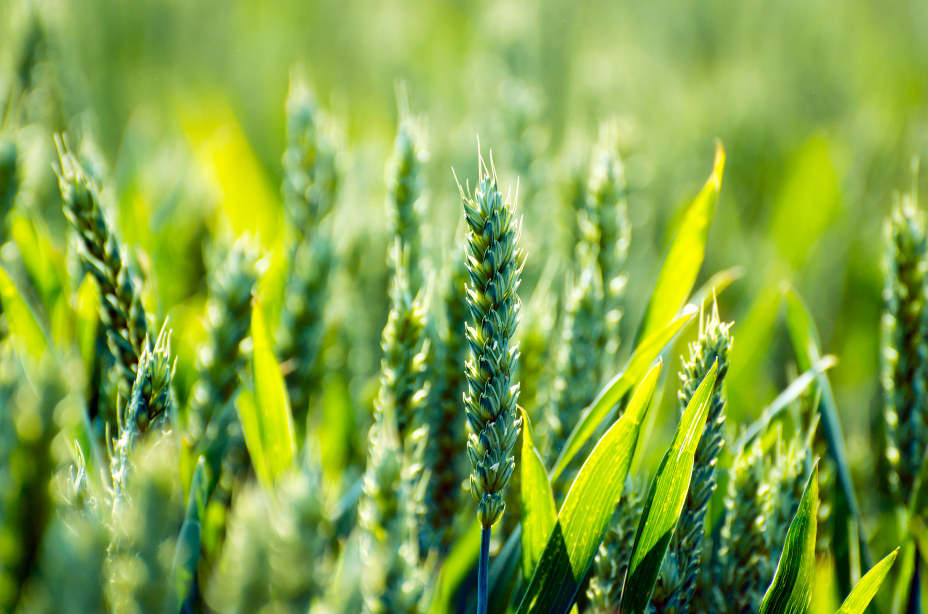
Key Focus
Introduction
• Import Data
• Transformation Data
• Data Modeling
• Data Visualization

Slide 3
Introduction
Indian agriculture is integral to the nation's economy, boasting a millennia-old heritage. It sustains millions, ensuring food security, employment, and economic growth.
With diverse climates and fertile lands, India cultivates a wide array of crops including cereals, pulses, fruits, and vegetables. It ranks among the world's top producers of horticultural goods.

Slide 4


Import Data

Slide 5
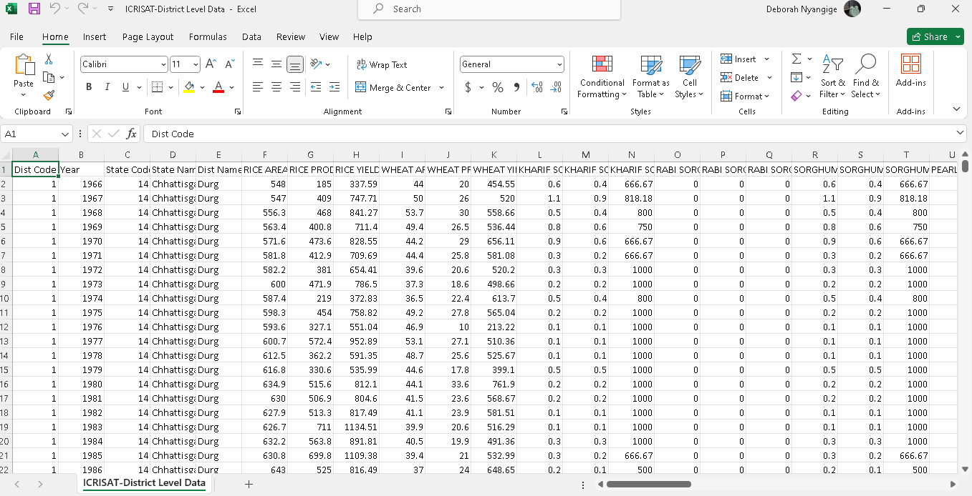
Data Overview

Slide 6
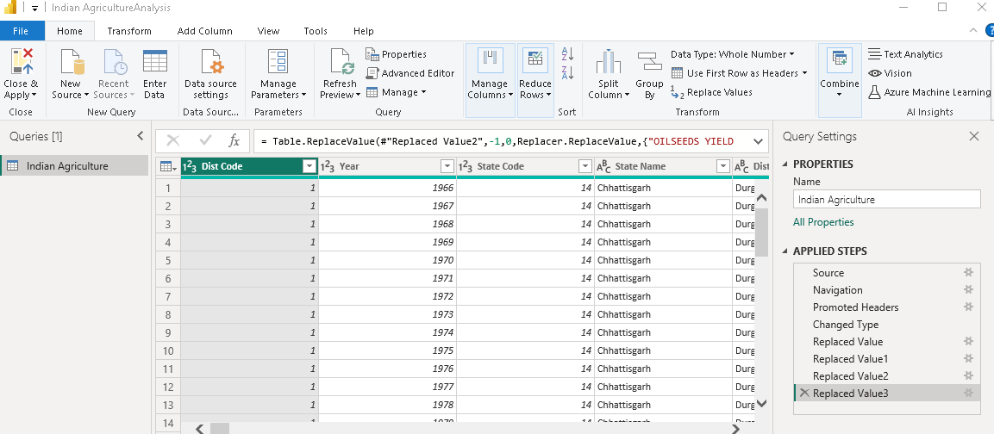
Transformation Data

Slide 7
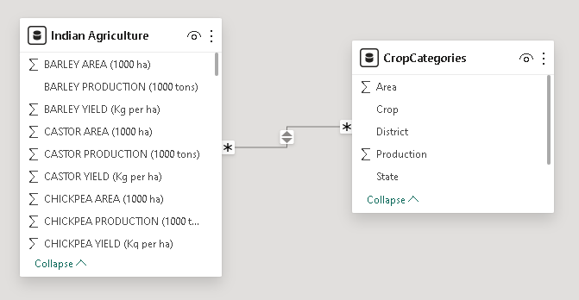
Data Modeling

Slide 8
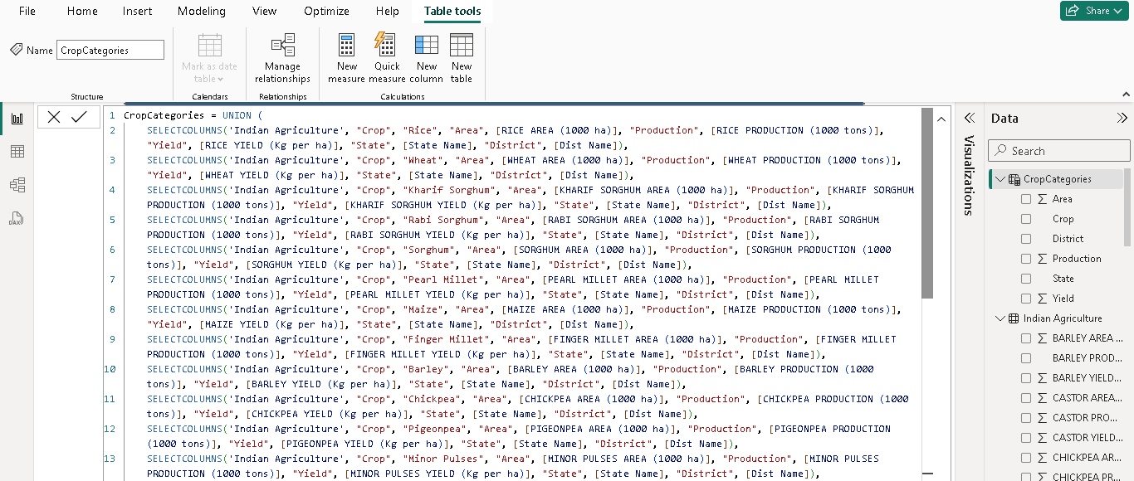
Data modeling: Crop Categorizing

Slide 9
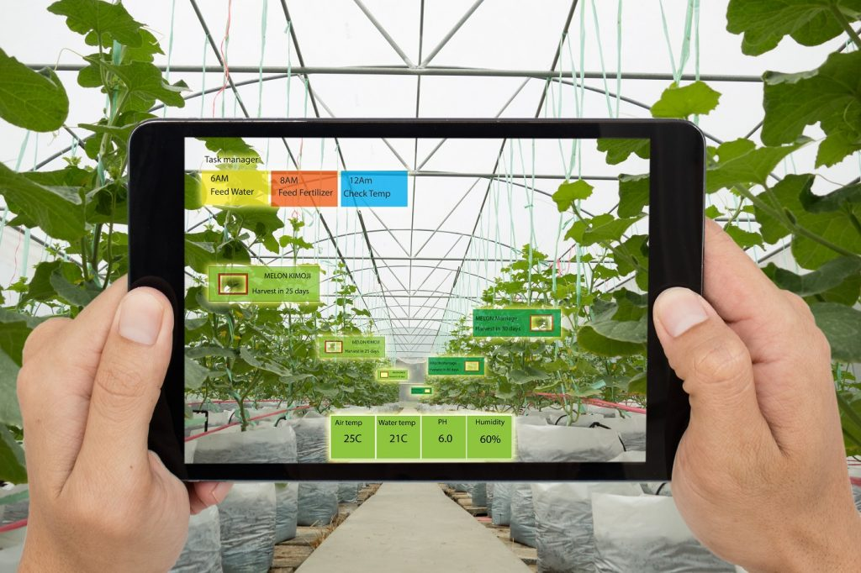
Data Visualization

Slide 10
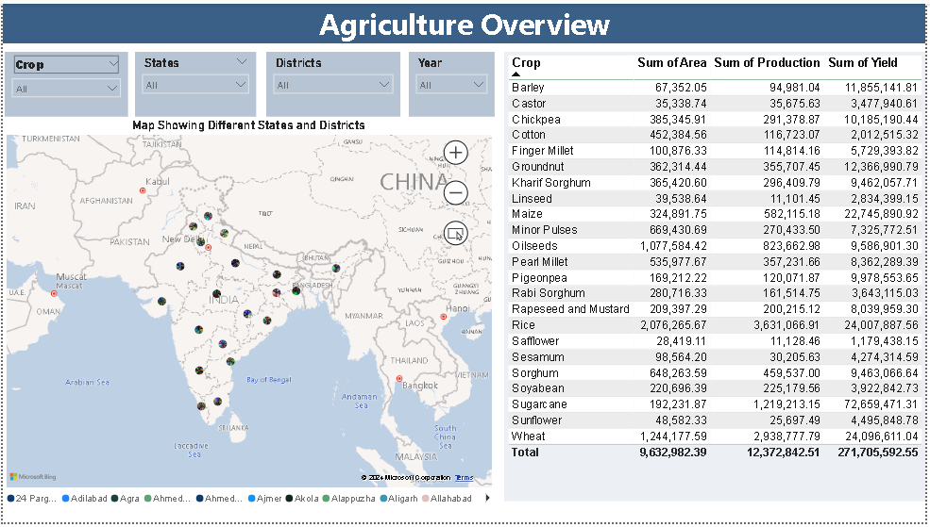

Slide 11
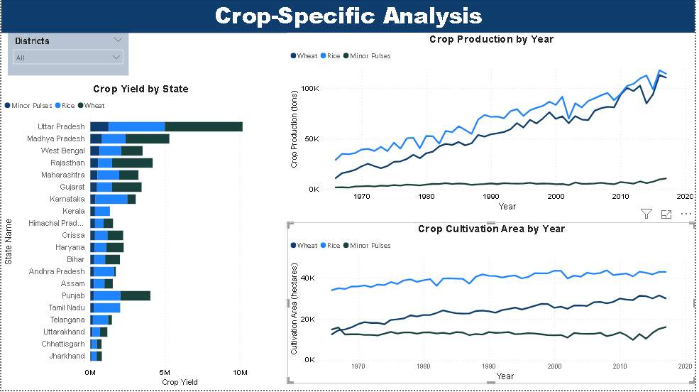

Slide 12
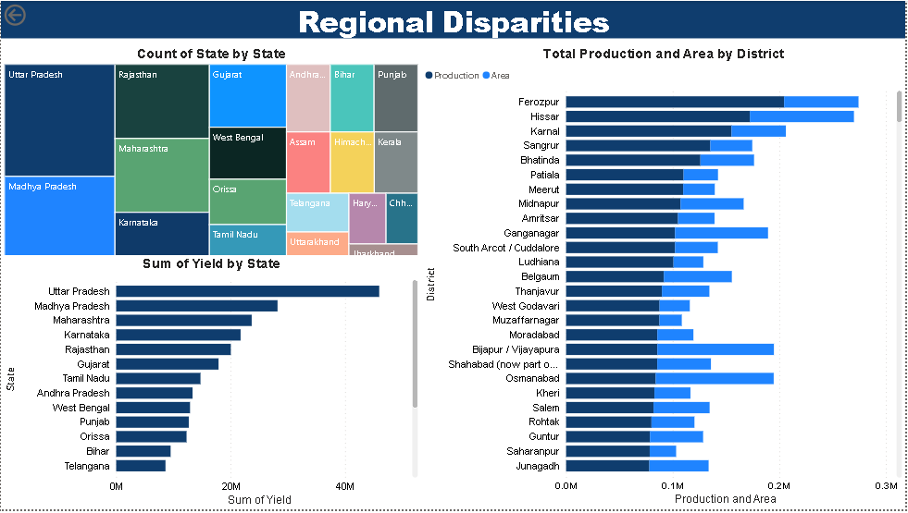

Slide 13
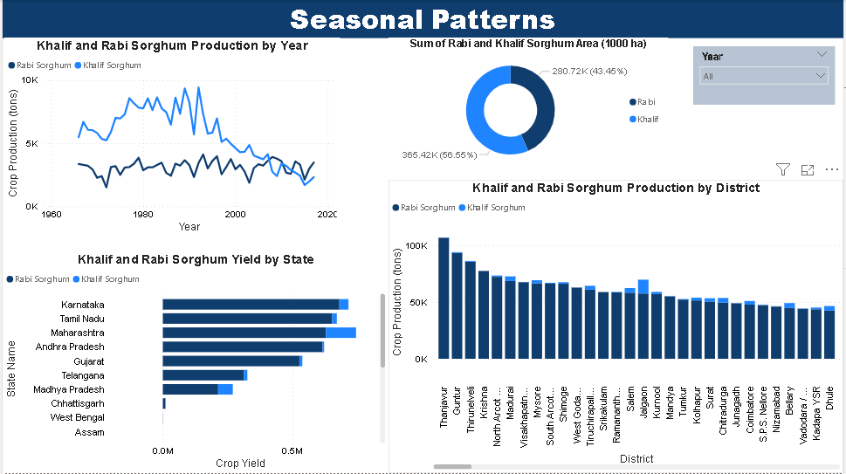

Slide 14
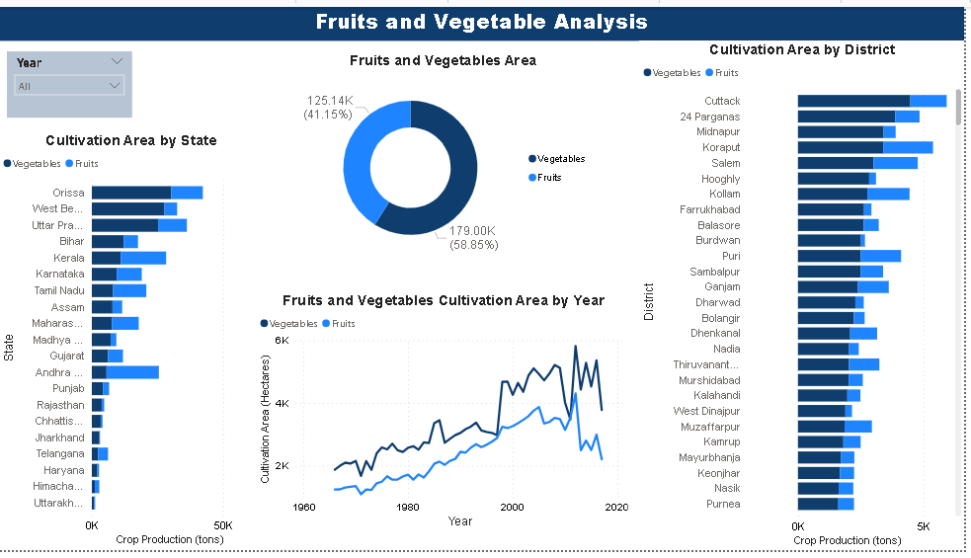

Slide 15
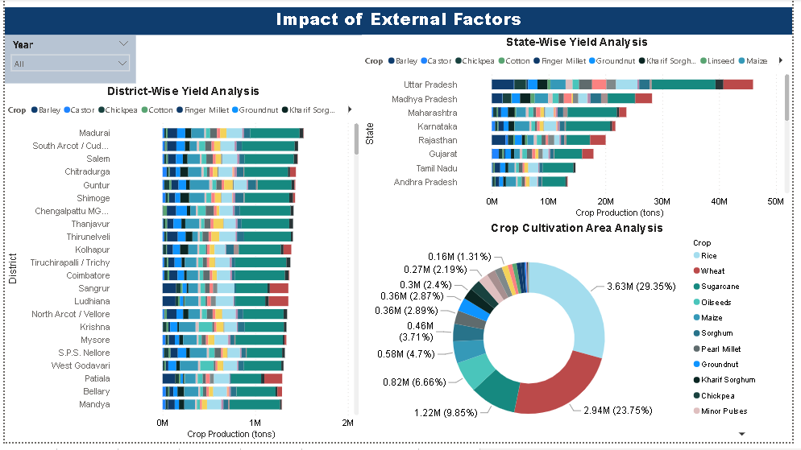

Slide 16
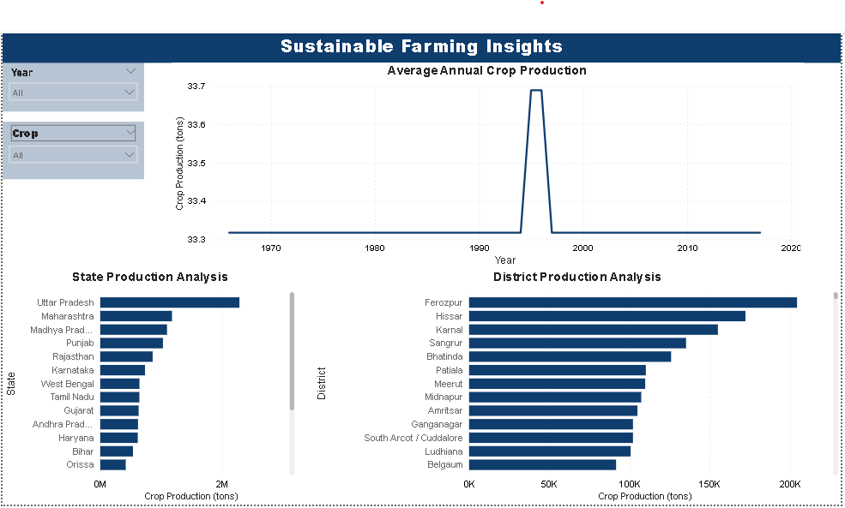

Slide 17
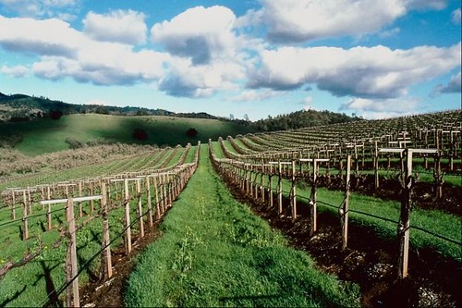
Conclusion
The Indian Agriculture Data Visualization project on Power BI equips stakeholders with actionable insights, empowering them to boost agricultural productivity, resilience, and sustainability. By utilizing intuitive visualizations, stakeholders can address intricate agricultural issues, make informed decisions, and advance Indian agriculture.

Slide 18
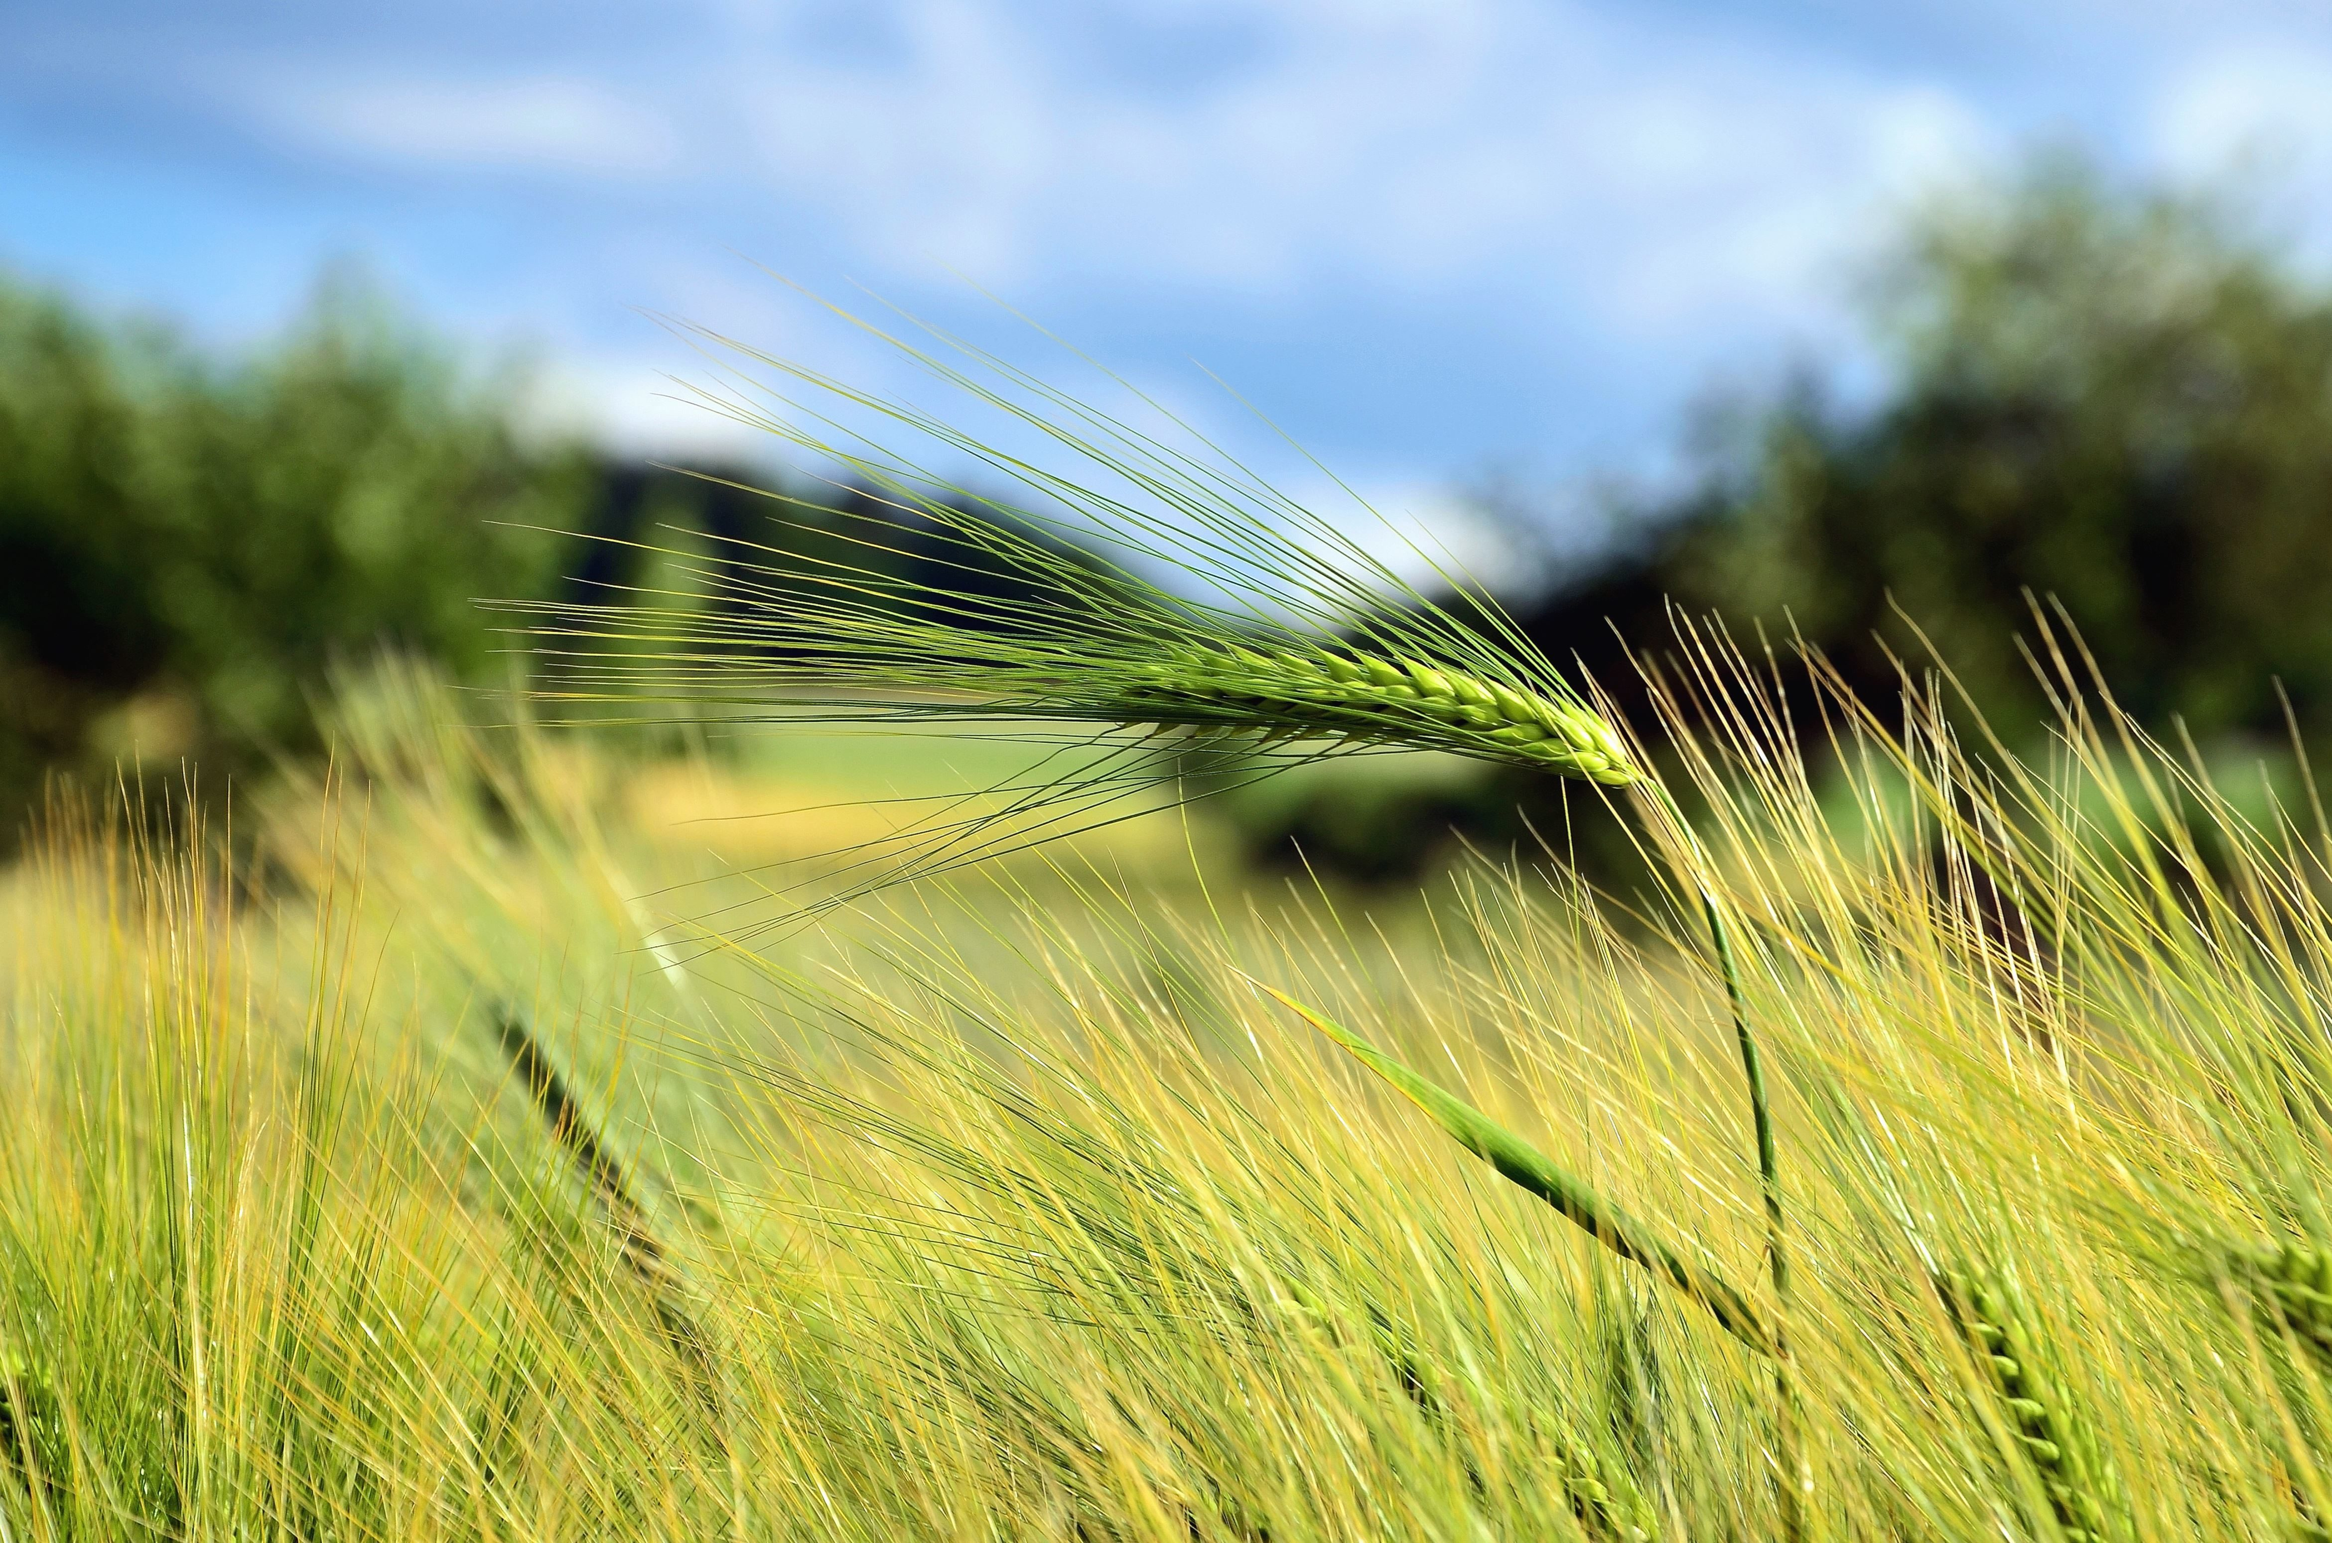
Thank You

